Slide 1
AIPI520 Week 2: Modeling Process

Slide 2
Modeling Process

Slide 3
Algorithm selection
Depending on our task, we have a variety of algorithms to choose from
No one algorithm is always better (“no free lunch theorem”)
Our selection will depend on three criteria:
Interpretability
Algorithm Selection
Computational Cost
Performance

Slide 4
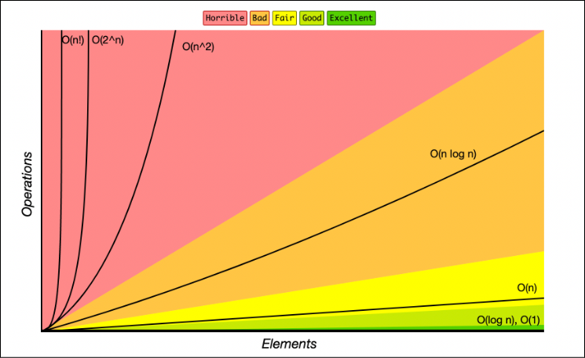
Computational cost
Time + memory
Training
Inference

Slide 5

Performance vs Interpretability
“Suppose you have cancer and you have to choose between a black-box AI surgeon that cannot explain how it works but has a 90% cure rate and a human surgeon with an 80% cure rate. Do you want the AI surgeon to be illegal?”
- Geoffrey Hinton

Slide 6

Occam’s Razor
All else being equal, choose the simpler solution.

Slide 7
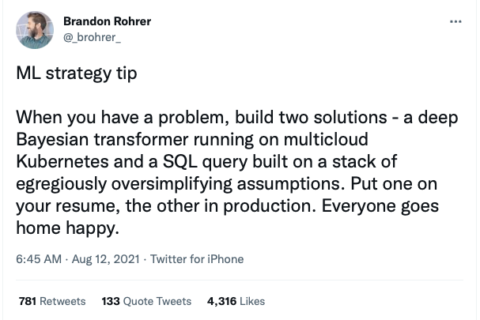

Slide 8
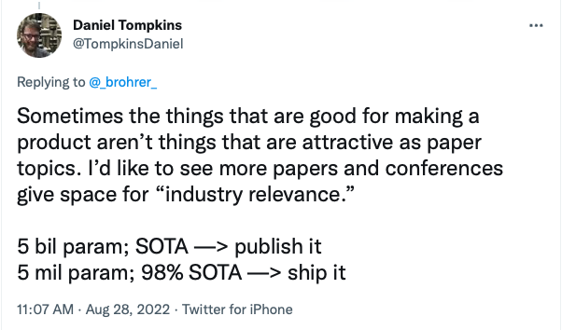

Slide 9
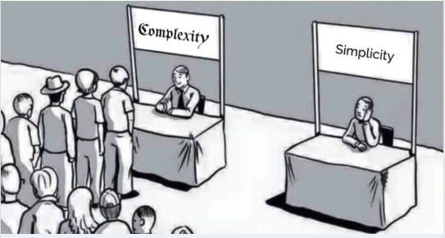
Why are simpler systems better
Easier to build, scale and maintain
Lower operational costs
Generalize better and are more robust to data drift
Do not necessarily perform worse than complex models
Tree-based models > deep neural networks on 45 mid-sized tabular datasets
Simple averaging ≥ complex optimizers on multi-task learning problems
Simple methods > complex methods in forecasting accuracy across 32 papers
Dot product > neural collaborative filtering in item recommendation and retrieval
Recommended article: https://eugeneyan.com/writing/simplicity/

Slide 10
Algorithm selection best practice
Start with developing a simple but reasonable heuristic, and measure the performance using your heuristic to make predictions
Next, apply a simple ML algorithm (e.g. linear regression, or KNN for classification) and evaluate performance to get a baseline
Now, experiment with different algorithms, keeping in mind the right balance between your three goals:
Performance
Interpretability
Computational efficiency

Slide 11
Model Evaluation

Slide 12
Training & Test Sets
Goal of predictive modeling is to create a model that makes accurate predictions on new unseen data
We cannot estimate performance on data we do not have, so instead we split our data into two sets
Training set - build and train the model
Test set – Evaluate model performance performance
Test
(~10-20%)
Training (~80-90%)
Use for model building & training
Use to evaluate final model

Slide 13
Sampling
Why do we sample?
We don’t have access to all possible data
It is infeasible to process all the data we have access to
Sampling occurs at multiple points
Sampling from the entire population to create training data
Sampling from the training data to create a test set
Sampling from the training data to do quick experiments
Two main types of sampling: nonprobability sampling and random sampling

Slide 14
Nonprobability sampling
Nonprobability sampling is when the selection of data is not based on any probability criteria
Types of nonprobability sampling:
Convenience sampling – samples selected based on their availability
E.g. Google Image Search for pictures of flowers
Snowball sampling – Future samples selected based on existing samples
E.g. scraping Twitter accounts based on users you follow
Judgment sampling – Domain experts decide what samples to use
Quota sampling – Select samples based on quotas for sub-groups
E.g. a survey where you collect 100 responses from users of each age group

Slide 15
Nonprobability sampling
Samples are not representative of real-world data and thus are highly likely to cause bias in your model
However, this is a very common approach in practice
Examples:
Large language models are trained on easily collected data – Wikipedia, Reddit, Common Crawl etc
Sentiment analysis models often trained on IMDB movie reviews or Amazon reviews – biased towards people who leave reviews online
Self-driving cars – initially trained only on Phoenix, AZ and Bay Area. Waymo later expanded to include Kirkland, WA for rainy weather

Slide 16
Random sampling
Random sampling involves randomly choosing samples from population
Several types:
Simple random sampling – all samples have equal probability of being selected
Downside – certain rare categories may not appear in the sampled data
Stratified sampling – divide population into groups you care about and sample a % randomly from each group
One challenge is that some observations may fall into multiple groups
Weighted sampling – each sample is given a weight which determines the probability of being selected
Allows you to apply domain expertise in selection e.g. weight recent data higher
Helps when your available data has a different distribution than the true data

Slide 17
Sampling for test set
Take a random sample of indices to use for test set, use remainder for training
Use Scikit-learn’s train_test_split method
If we want to do stratified sampling we use the ‘stratify’ parameter

Slide 18
Data Leakage
“Data leakage” occurs when some of our test set data “leaks” into model building and influences the development of the model
For example, if we use all of our data to select our features, or compare algorithms
This invalidates the estimated performance of the model and causes it to be overoptimistic
In severe cases, it can cause our model to be worthless

Slide 19

Data Leakage
Data from the future is accidentally used within training data

Slide 20
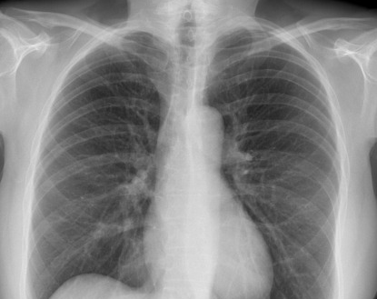
Data Leakage
A variable within the training data is an indicator of the target

Slide 21
Common causes of data leakage
Not good but not terrible
Very severe
Selecting features before splitting
Scaling before splitting
Filling missing values before splitting
Grouped observations are separated into different splits
E.g. two CT scans from the same patient taken a week apart
Splitting time series data randomly instead of by time
Failure to remove duplicate observations
Particularly dangerous when merging multiple datasets together
Common issue in several studies using ML to detect COVID-19
Different data generation processes for different classes

Slide 22
Comparing Models

Slide 23
Comparing models- validation sets
Often we want to compare models to select the optimal model
If we use the test set to compare model performance, it is not longer an unbiased indicator of performance
Instead, we split the data 3 ways into training, validation and test sets
We use the validation set for model selection, and report performance on the test set
Training
(~60-80%)
Validation
(~10-20%)
Test
(~10-20%)
Use for model comparison/selection
Use to evaluate final model

Slide 24
Question
What might be some potential problems with using a validation set to do your model selection?
Training
(~70-80%)
Validation
(~10-20%)
Test
(~10-20%)
Use for model comparison/selection
Use to evaluate final model
Notes:
It takes away data from training, which can be a problem if the dataset is small
The model performance calculation is strongly influenced by selection of which points are in the validation set

Slide 25
Cross-Validation

Slide 26
K-Folds Cross Validation
Rather than using a fixed validation set, we train and run the model(s) multiple times, each time using a different subset (“fold”) as the validation set
K=5 Folds
Training + cross-validation
(~80-90%)
Test
(~10-20%)
Iteration 1
Val set
Iteration 2
Val set
Iteration 3
Val set
Iteration 4
Val set
Iteration 5
Val set
Use for model comparison/selection
Use to evaluate final model
K
Validation fold
Training folds

Slide 27
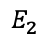
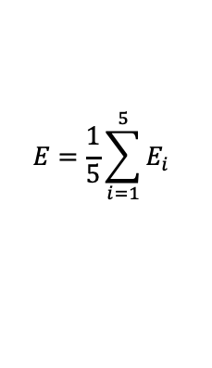
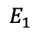
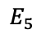
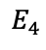
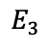
K-Folds Cross Validation
We calculate the error on the validation fold for each iteration, and then average them together to get the average error
K=5 Folds
Iteration 1
Val set
$$E_{1}$$
Iteration 2
Val set
$$E_{2}$$
$$E=\frac{1}{5}\sum_{i=1}^{5}{E_{i}}$$
Iteration 3
Val set
$$E_{3}$$
Iteration 4
Val set
$$E_{4}$$
Iteration 5
Val set
$$E_{5}$$
K
Validation fold
Training folds

Slide 28
Other types of cross-validation
ShuffleSplit cross-validation
For each fold, we randomly select a % of observations to use for validation and use the rest for training
E.g. we can set K=4 and validation % = 10%. Each fold, we randomly select 10% of observations for validation
This can cut down on compute time, but the tradeoff is we may use observations multiple times, or not use some observations, introducing bias
Leave-one-out cross-validation
Set K = number of points
Each observation becomes a validation set one time, and all other observations are used for training
Average your performance over all K folds

Slide 29
Why use cross-validation?
Maximizes the data available for training the model – important for small datasets
Provides a better evaluation of how well the model can generalize to new data – validation performance is not accidentally biased by choice of datapoints to use for validation
Cross-validation is the typical approach used in industry for model selection and tuning, except in cases of very large datasets

Slide 30
CV and Model Evaluation
Remember, when you complete your cross-validation and do your model selection, you still need to evaluate your model on the test set for a fair approximation of performance
Training + cross-validation
(~80-90%)
Test
(~10-20%)
Iteration
1
2
3
4
5
Val set
Val set
Val set
Val set
Val set
Use for model comparison/selection
Use to evaluate final model
Validation fold
Training folds

Slide 31
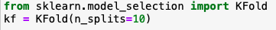
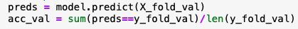
CV using Scikit-learn
Divide data into ”k” folds
For each model you want to compare:
For each of “k” iterations:
Get the training folds and the validation fold for the iteration
Fit the model on the training data
Get predictions for the validation fold, calculate performance and store it
Calculate mean validation performance across all iterations
Compare CV average performance and select model

Slide 32
Model Selection: The Bias-Variance Tradeoff

Slide 33
Model Complexity
Model Complexity
Number of Features
Algorithm
Hyper-parameter Values

Slide 34
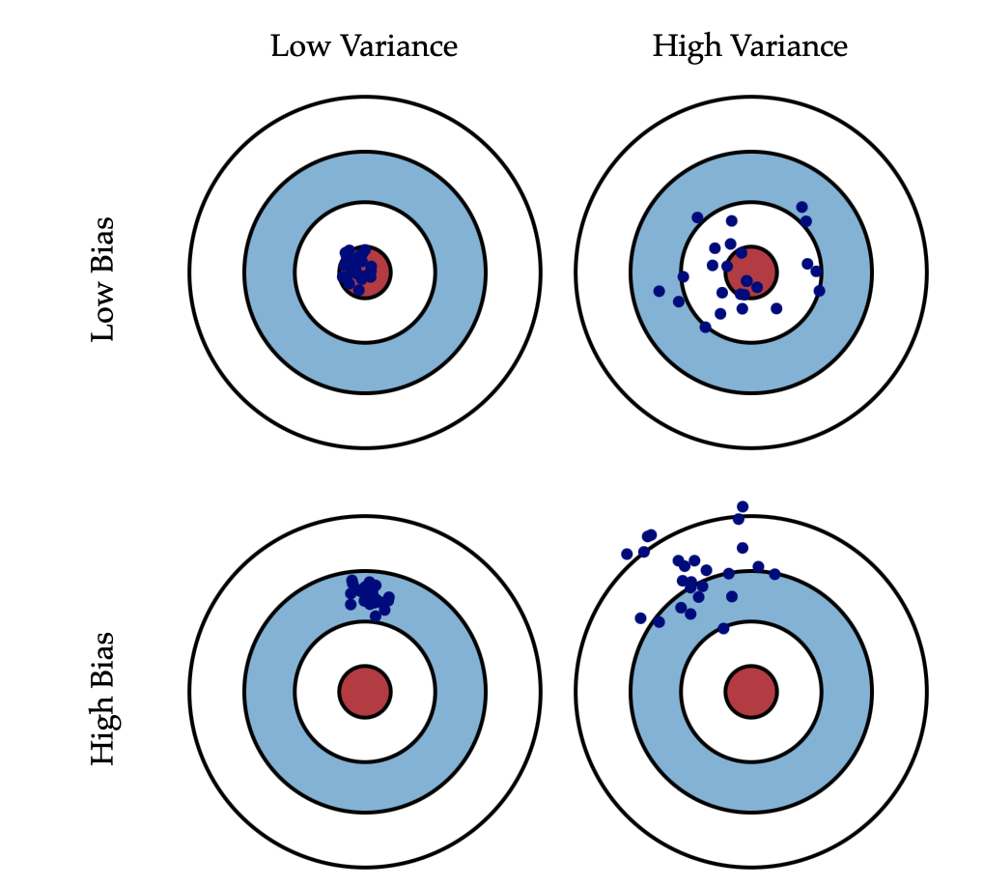
Bias and Variance
Bias is error from incorrect assumptions within the model
Often introduced by modeling a real-life problem using a simpler model that is unable to fully capture the underlying patterns in data
Variance refers to the sensitivity of the model to fluctuations in the training data
Usually due to model fitting itself to fine patterns which may just be noise
See: http://scott.fortmann-roe.com/docs/BiasVariance.html

Slide 35
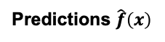
Bias – Variance Tradeoff
For a model y= $\hat{f}\left(x\right)$, at any point (x,y):
Bias
Predictions $\hat{f}\left(x\right)$
$$(y−E\left[\hat{f}\left(x\right)\right])$$
Expected Squared Error $=E\left[{\left(y−\hat{f}\left(x\right)\right)}^{2}\right]$
=${ (y−E\left[\hat{f}\left(x\right)\right])}^{2} + E\left[({\hat{f}\left(x\right)−E\left[\hat{f}\left(x\right)\right])}^{2}\right]+σ_{e}^{2}$
Target $y$
$$E\left[\hat{f}\left(x\right)\right]$$
Bias²
Variance
Expected Error
Deviation
$$E\left[\hat{f}\left(x\right)−E\left[\hat{f}\left(x\right)\right]\right]$$
= ${Bias}^{2}+Var+σ_{e}^{2}$
Irreducible error

Slide 36
Bias – Variance Tradeoff
$Total Error= {Bias}^{2}+Var+σ_{e}^{2}$
Bias and variance move in opposite directions
Simpler models often have higher bias and lower variance
Complex models typically have lower bias but higher variance
Optimal model complexity
Total error
Variance
Error
Bias²
Model complexity

Slide 37
Underfitting vs. Overfitting
Underfitting
Model is too simple
Total error
Overfitting
Model is too complex
Optimal model complexity
Optimal model complexity
Total error
Variance
Variance
Error
Error
Bias²
Bias²
Model complexity
Model complexity
Image source: http://scott.fortmann-roe.com/docs/BiasVariance.html

Slide 38
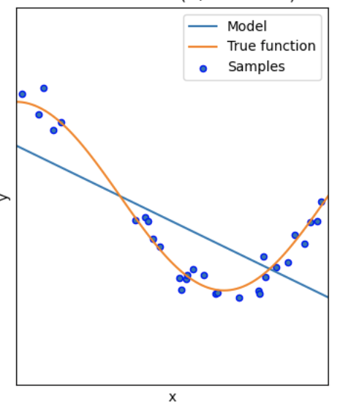
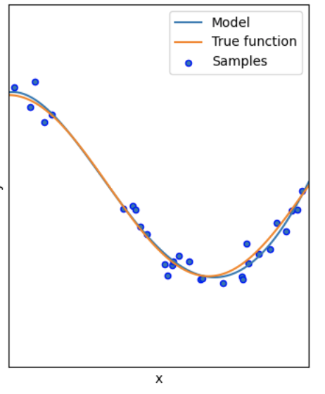
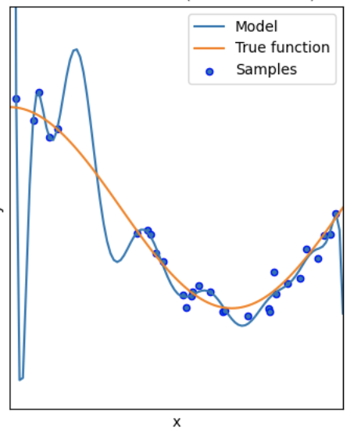
Underfitting vs. Overfitting
Underfitting
Model is too simple
Good Fit
Model fits well, with some error
Overfitting
Model is too complex
Image source: Scikit Learn documentation

Slide 39
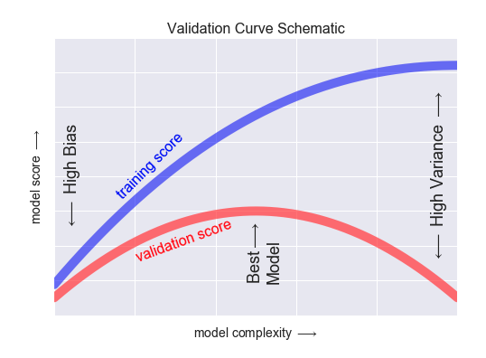
How do we recognize overfitting?
As we increase complexity, training score continues to improve
However, validation score improves to a point but then drops as model overfits the training data
Eventually, training performance & validation performance diverge indicating model is overfit
Image source: Python Data Science Handbook

Slide 40
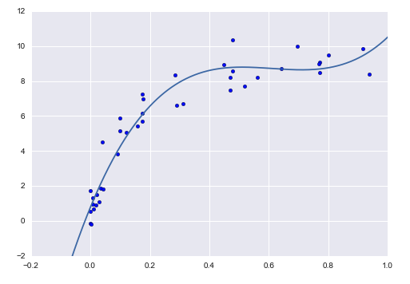
Finding the optimal model
Our goal is to find the optimal model complexity to balance bias and variance, thereby minimizing error
What influences complexity?
Choice of algorithm
Number of features
Hyperparameter settings
Optimal complexity varies with amount of data – the more data, the more complex model you can use
We find this using the validation approaches we discussed last class
Image source: Python Data Science Handbook

Slide 41
DEMO: Validation Curves

Slide 42
Metrics

Slide 43
Outcomes vs. Outputs
Outcome
Output
Refers to the desired business impact on your organization or for your customer
Stated in terms of the expected impact (which is often $)
Does NOT contain model performance metrics or other technical metrics
Refers to the desired output from the model
Measured in terms of a model performance metric
Typically not communicated to the customer
Set this AFTER setting the desired outcome

Slide 44
Outcomes vs. Outputs
A tool to predict turbulence for airlines
A power demand forecasting tool for a utility
Outcome
Low # of safety incidents per year, or lower $ of safety-related claims
Lower cost per MWh of power produced
Lower emissions rate per MWh
Output
AUROC or precision/recall of turbulence prediction (binary or 1-5 scale)
MSE (most likely) or MAE/MAPE

Slide 45
Thought Exercise
Suppose we work for an ecommerce company and have been asked to determine whether we should move from batch prediction to online prediction for our recommended products feed.
How would we go about determining whether we should do this?

Slide 46
Hypothesis
X% improvement in recommendation accuracy
Y% increase in purchase rate
Purchases = f(Accuracy)
How do we determine what % improvement in recommendation performance we can get?
How do we determine what % increase in purchase rate we can expect?

Slide 47
Hypothesis
X% improvement in recommendation accuracy
Y% increase in purchase rate
Purchases = f(Accuracy)
How do we determine what % improvement in recommendation performance we can get? A/B testing
How do we determine what % increase in purchase rate we can expect? Historical data

Slide 48
Baselines
Metrics are meaningless without a baseline for comparison
There are a few important baselines to determine:
Zero rule baseline (Most common class / mean value)
Heuristic baseline
Human baseline
Existing solution baseline

Slide 49
Regression Error Metrics

Slide 50
MSE, MAE and MAPE
Mean Squared Error
Mean Absolute Error
Mean Absolute % Error
$$MSE= \frac{1}{n}\sum_{i}{{(y_{i}−{\hat{y}}_{i})}^{2}}$$
$$MAE= \frac{1}{n}\sum_{i}{|y_{i}−{\hat{y}}_{i}}|$$
$$MAPE= \frac{1}{n}\sum_{i}{\frac{|y_{i}−{\hat{y}}_{i}|}{y_{i}}}$$
Most popular regression error metric
Heavily influenced by outliers - penalizes large errors much more than small ones
Influenced by scale of data
Sometimes used as RMSE
Also influenced by scale
More robust to outliers
Can be easier to interpret in context of the problem
Abs value is less desirable for calculations (squared terms are easier to minimize via differentiation)
Converts error to a percentage
Popular among non-technical managers because it is easily understood
Skewed by high % errors for low values of y

Slide 51
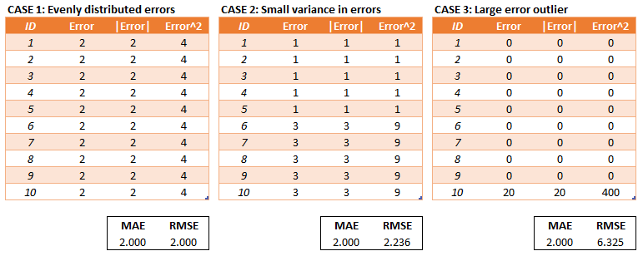
Example: MAE vs. MSE/RMSE
MSE/RMSE penalizes severe errors much more than MAE
This can be desirable if being off by a lot one time is much worse than being off by a little every time
Image source: https://medium.com/human-in-a-machine-world/mae-and-rmse-which-metric-is-better-e60ac3bde13d

Slide 52
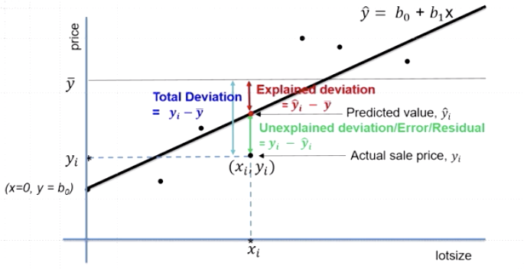
Coefficient of determination (R²)
Deviation of points from mean can be broken down into two components:
”Explained deviation” – portion of deviation predicted by your model
“Unexplained deviation” – difference between prediction and actual point

Slide 53
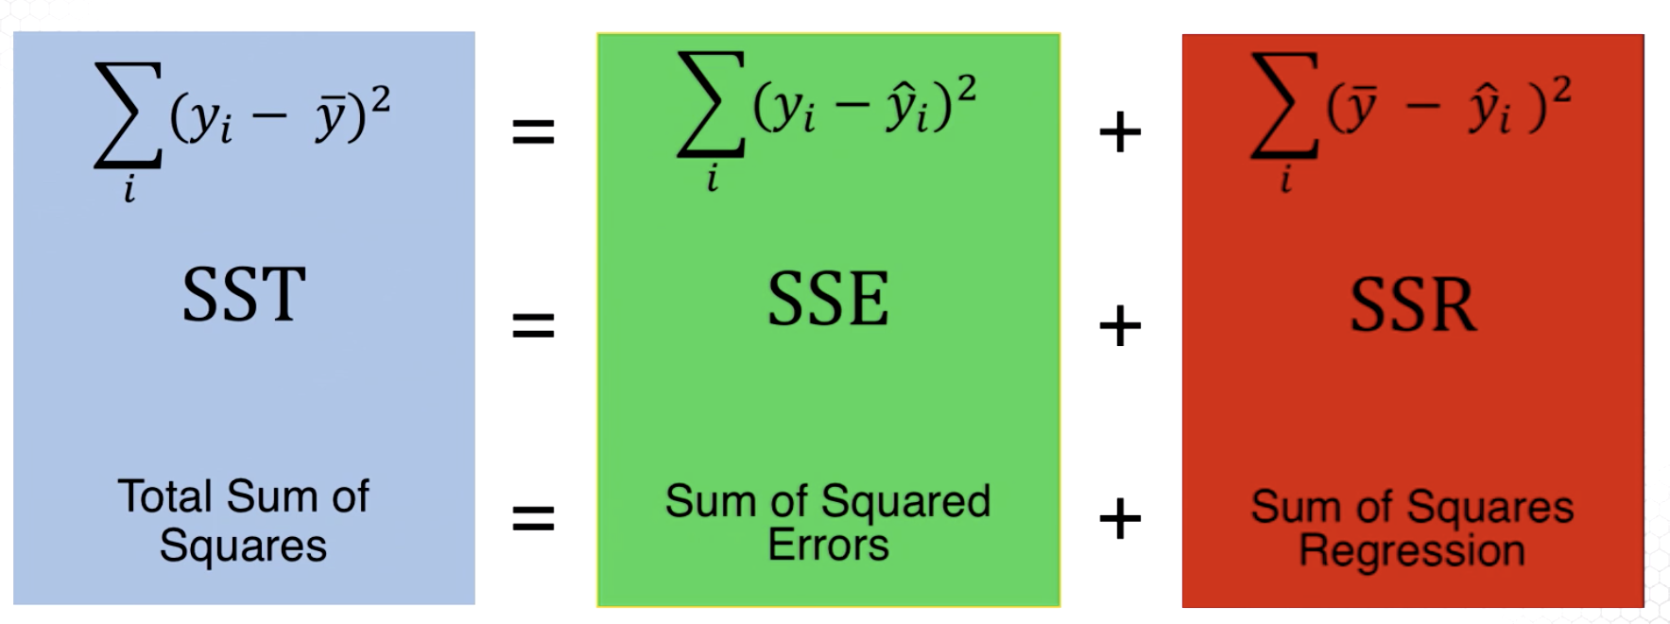
Coefficient of determination (R²)
Total deviation from mean
Unexplained deviation (error)
Deviation explained by model
$$R^{2}=\frac{SSR}{SST}=1−\frac{SSE}{SST}$$
R-squared is typically used to communicate how well your feature variables (X) explain the variability in your target variable (y)
R² ranges between 0 and 1

Slide 54
Adjusted R²
R-squared is often viewed as a measure of goodness of fit rather than prediction ability -> calculated “in-sample” on the training data itself
As we add more features, the R-squared almost always goes up because the model finds additional patterns of correlation (which might be noise)
However, this does not mean the model can generate better predictions on new data -> remember our discussion on overfitting
To help with this problem, we often report ”adjusted R-squared”, which penalizes for more features (added complexity)
$$Adjusted R^{2}=1−\frac{(1−R^{2})(n−1)}{(n−p−1)}$$
“Is R-squared useless?”: https://data.library.virginia.edu/is-r-squared-useless/

Slide 55
How to calculate these metrics?
Calculate them manually or use sklearn.metrics
Remember: calculate these on the validation and/or test sets (depending on whether you are comparing models or evaluating a model)
Metric | sklearn function
Mean squared error (MSE) | mean_squared_error(y_true,y_pred)
Mean absolute error (MAE) | mean_absolute_error(y_true,y_pred)
Mean absolute % error (MAPE) | [NEW in 0.24] mean_absolute_percentage_error(y_true,y_pred)
Coef. of determination (R²) | r2_score(y_true,y_pred)

Slide 56
Exercise: Regression metrics

Slide 57
Classification Error Metrics

Slide 58
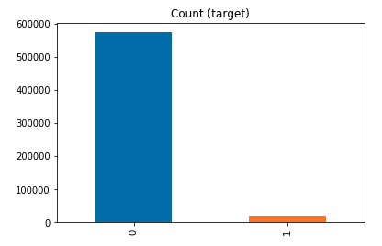
Accuracy
Accuracy is the most popular and easiest to understand error metric
However, accuracy can be deceiving when there is a class imbalance
Consider this situation:
I am building a model to predict whether patients will have a certain rare disease
I gather a dataset with thousands of patients and several features, along with a label of whether they were diagnosed with the rare disease (“1”) or not (“0”)
Using this dataset, I create a classifier with 99.4% accuracy!
What’s the problem?
My dataset had very high class imbalance
My model just predicted “0” for every patient
And it was right 99.4% of the time!

Slide 59
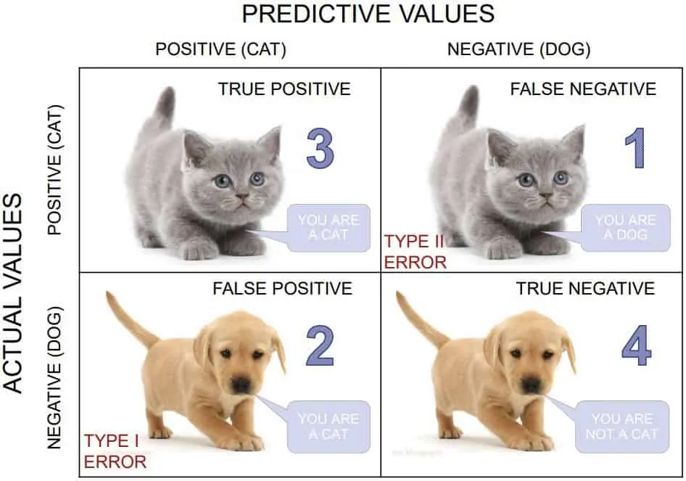
Confusion Matrix – Binary Classification
Predicted class, $\hat{y}$
1
(Positive)
0
(Negative)
True positives
False negatives
1
(Positive)
True class, $y$
False positives
True negatives
0 (Negative)

Slide 60
Confusion Matrix – Binary Classification
Predicted class, $\hat{y}$
True Positive Rate (TPR)
Recall
Sensitivity
How many of all positives did the model correctly classify as positives?
1
(Positive)
0
(Negative)
True positives
False negatives
1
(Positive)
True positives
True class, $y$
False positives
True negatives
0 (Negative)
All positives
True positives
False negatives
+

Slide 61
Confusion Matrix – Binary Classification
Predicted class, $\hat{y}$
False Positive Rate (FPR)
How many of all negatives did the model incorrectly classify as positives?
1
(Positive)
0
(Negative)
True positives
False negatives
1
(Positive)
False positives
True class, $y$
False positives
True negatives
0 (Negative)
All negatives
False positives
True negatives
+

Slide 62
Confusion Matrix – Binary Classification
Predicted class, $\hat{y}$
Precision
How many of the predicted positives are actually positives?
1
(Positive)
0
(Negative)
True positives
False negatives
1
(Positive)
True positives
True class, $y$
False positives
True negatives
0 (Negative)
All predicted positives
True positives
False positives
+

Slide 63
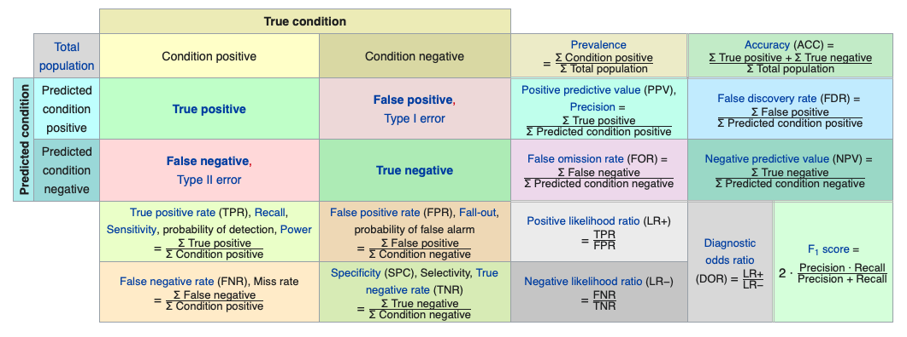
Confusion matrix cheat sheet
Source: Wikipedia

Slide 64
Question
Our model predicts every observation as “positive”
Is the recall / true positive rate high or low?
What about the false positive rate?
How about the precision?

Slide 65
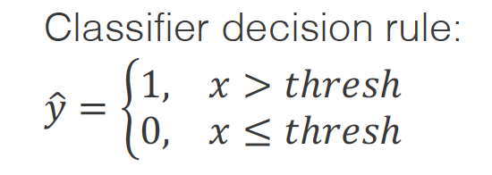
ROC Curves
A Receiver Operating Characteristic (ROC) curve plots the True Positive Rate (TPR) and False Positive Rate (FPR) for different threshold values
What is a threshold?
Most classification models return the probability of the positive class
The data scientist sets a threshold for the positive class – if the probability returned by the model is above threshold, the assigned label is positive
Typically the threshold is set to 0.5 by default
What happens to TPR if we increase the threshold to 0.9?
What about FPR?
What if we go the other way to 0.1?

Slide 66
ROC Curves
 | Model Output | Actual Target | Thresh = 0.3 | Thresh = 0.5 | Thresh = 0.7
1 | 0.85 | 1 | 1 | 1 | 1
2 | 0.04 | 0 | 0 | 0 | 0
3 | 0.62 | 1 | 1 | 1 | 0
4 | 0.37 | 0 | 1 | 0 | 0
5 | 0.55 | 0 | 1 | 1 | 0
TPR |  |  | 2/2 | 2/2 | 1/2
FPR |  |  | 2/3 | 1/3 | 0/3
To build a ROC curve:
Run the model and get the output probabilities
For each value in range(0,1):
Set value as threshold value
Calculate predictions by comparing model output probabilities to threshold
Compare the predictions to targets and calculate the TPR and FPR values
Plot the values for all thresholds on a graph of TPR vs FPR

Slide 67
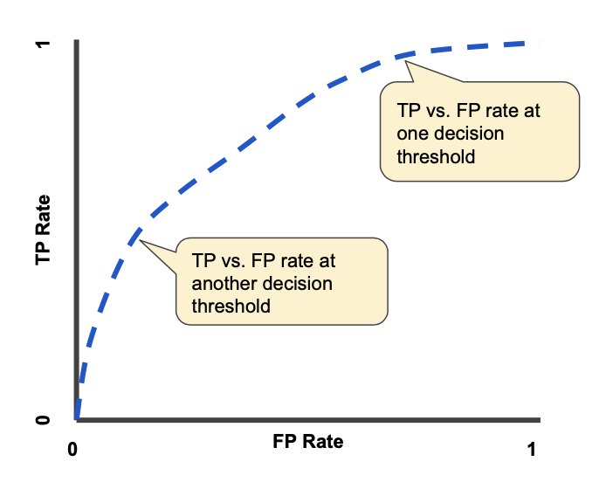
ROC Curves
True positives
True positives
+
False negatives
To build a ROC curve:
Run the model and get the output probabilities
For each value in range(0,1):
Set value as threshold value
Generate predictions by comparing model output probabilities to threshold
Compare the predictions to targets and calculate the TPR and FPR values
Plot the values for all thresholds on a graph of TPR vs FPR
False positives
False positives
+
True negatives
Image source: https://developers.google.com/machine-learning/crash-course/classification/roc-and-auc

Slide 68
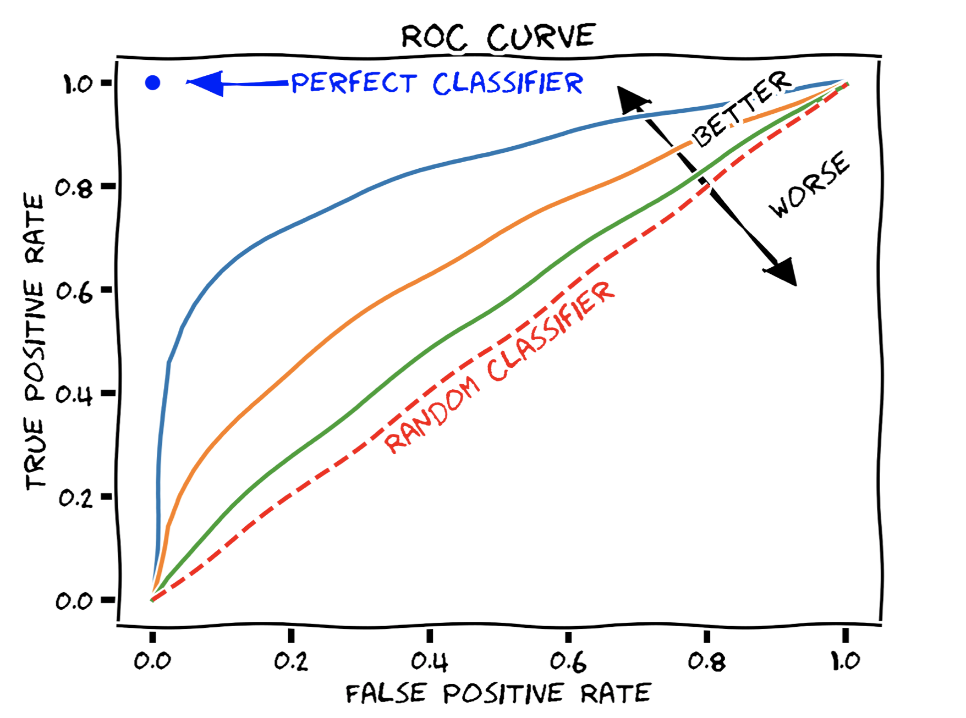
Area Under ROC (AUROC)
A common error metric for classification models is AUROC
This represents the area under the ROC curve
A perfect classifier will have have AUROC=1
A random classifier will have AUROC=0.5
Why? See: https://datascience.stackexchange.com/questions/31872/auc-roc-of-a-random-classifier
Therefore, a model should have an AUROC between 0.5 and 1 (higher is better)
https://en.wikipedia.org/wiki/Receiver_operating_characteristic#/media/File:Roc-draft-xkcd-style.svg

Slide 69
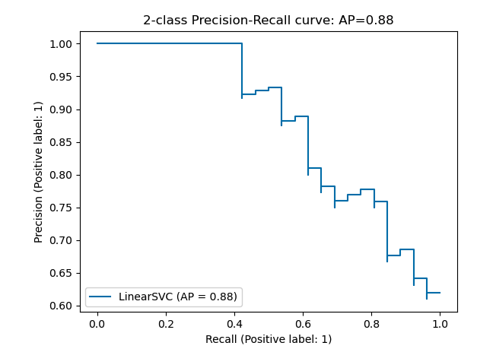
Precision-Recall Curve
True positives
Another evaluation technique is the precision-recall (PR) curve
This measures the tradeoff between recall and precision as the model threshold is varied (just like we did for the ROC)
PR curves are especially useful if we have high class imbalance (e.g. a lot of 0’s and only a few 1’s)
Unlike ROC curves, they do not factor in True Negatives
True positives
+
False positives
True positives
True positives
+
False negatives
Image source: https://scikit-learn.org/stable/auto_examples/model_selection/plot_precision_recall.html#sphx-glr-auto-examples-model-selection-plot-precision-recall-py

Slide 70
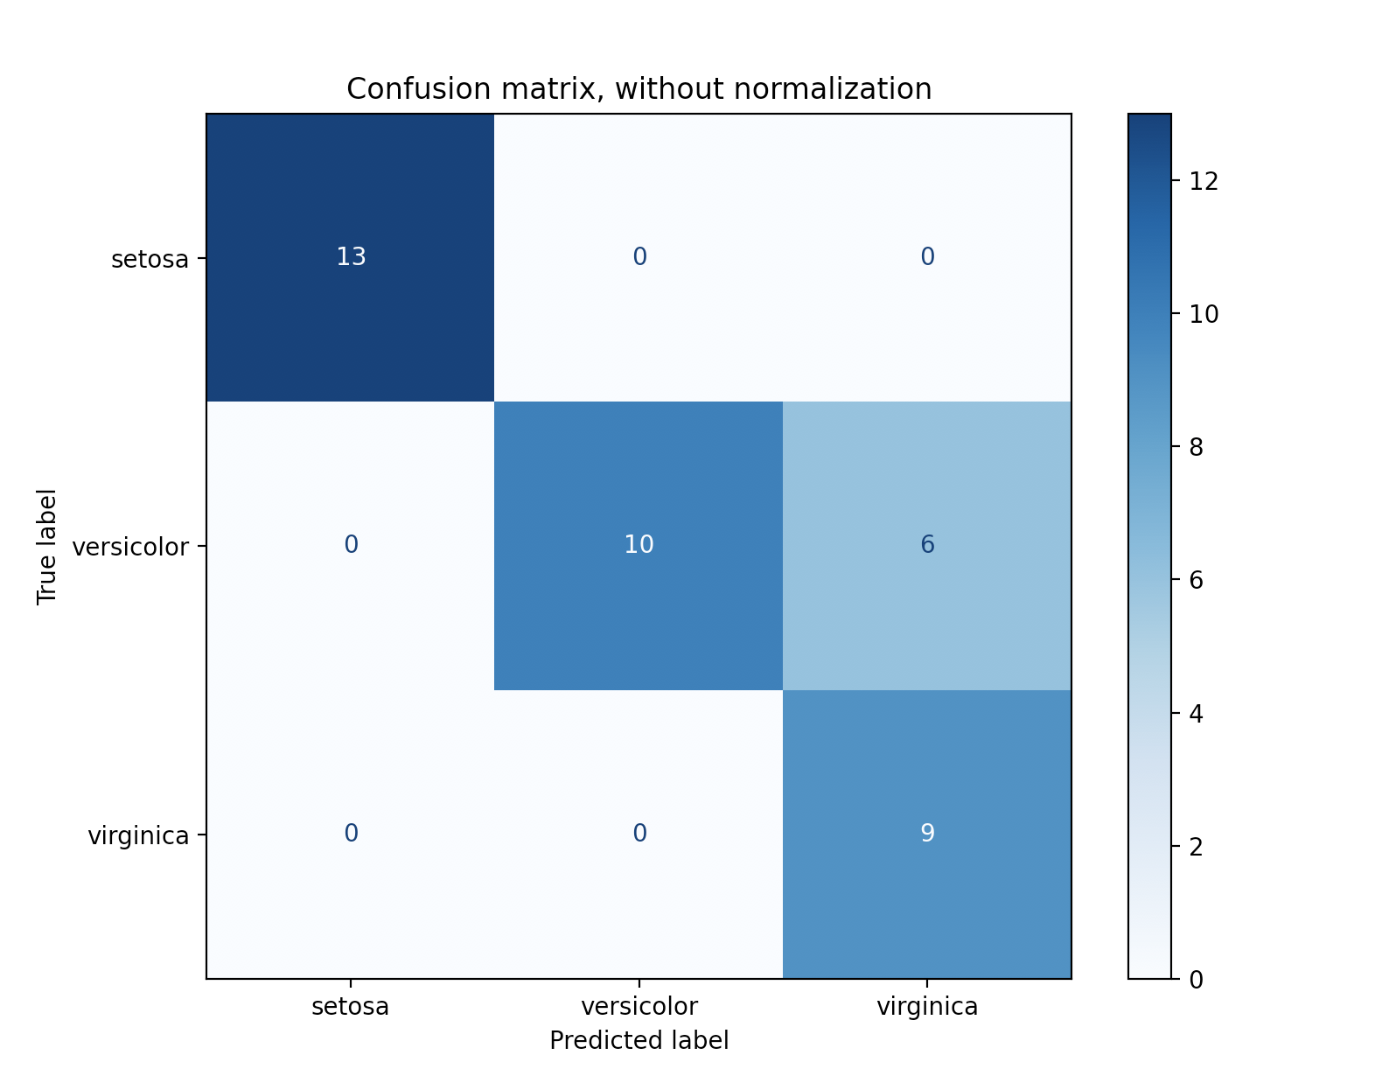
Multiclass Confusion Matrix
The multiclass confusion matrix shows us where the classifier model is struggling to differentiate between classes
A perfect classifier would have values only on the diagonals
To plot the confusion matrix we use scikit learn’s plot_confusion_matrix() method

Slide 71
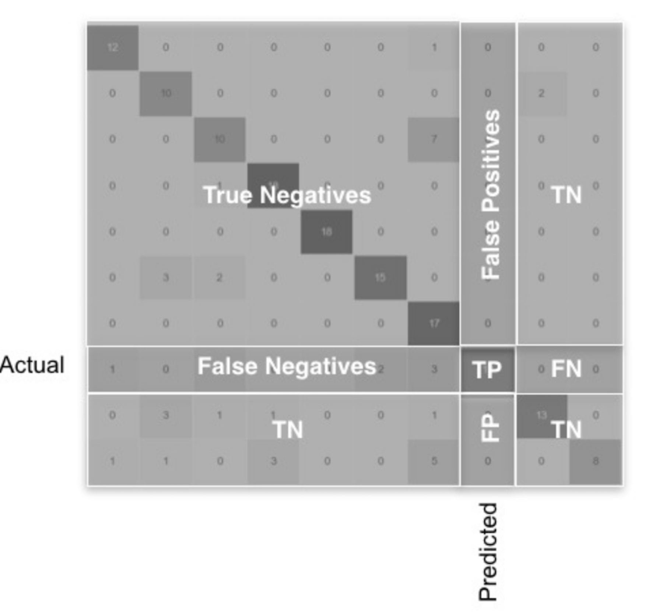
Multiclass Confusion Matrix
We can calculate the same metrics as we did before, but now we do it for each class
Scikit learn will do this for us using the classification_report() method
We can also report overall “macro-averaged” precision and recall using a simple average across all classes
Image source: https://towardsdatascience.com/multi-class-classification-extracting-performance-metrics-from-the-confusion-matrix-b379b427a872

Slide 72
F₁ Score
Precision or recall alone do not give us the whole picture of how well our classifier is doing, particularly for data with high class imbalance
We can use the F₁ score, which takes both precision and recall into account
$$F_{1}=2∗\frac{precision∗recall}{precision+recall}$$
This is common in academic papers but needs to be used carefully, because it gives equal weight to precision and recall
E.g. classifying a healthy person as sick can have very different consequences as classifying a sick person as healthy

Slide 73
DEMO: Classification metrics

Slide 74
Wrap-Up: Metric Selection
Selecting proper metrics is a key activity of Step 1 of the CRISP-DM process: Business Understanding
What we have discussed today is “output metrics”, but it is even more important to consider “outcome metrics”
Your choice of metric should reflect the nature of your problem and the consequences of being wrong
E.g. for a regression problem, is it much worse to be very wrong a few times, or a little wrong a lot of times?
Or, for a classification problem, are false positives or false negatives worse?

